Slide 1
Read Write Inc. Phonics
Parents’ Meeting
Set 2 and Set 3 Sounds

Slide 2
Reading changes everything
Teach a child to read and keep that child reading and we will change everything.
And I mean everything.
Jeanette Winterson
Notes:
Read quote.
Today I want to help you understand how your child is learning to read the next group of sounds in Read Write Inc. Phonics: Set 2 and Set 3 sounds.

Slide 3
Speed Sounds Set 2
Notes:
Set 2 sounds are shaded. They are long vowel sounds with 2 or more letters. We call these ‘Special Friends’ – two letters together that make one sound.
Once children know these Set 2 sounds, they know one way of reading and writing every sound.

Slide 4
Speed Sounds Set 3
Notes:
Once children know how to read Set 2 sounds, they start to learn Set 3 sounds.
These are shaded in the chart.
They are alternative graphemes (spelling of a sound) for the Set 1 and Set 2 sounds the children already know.
For example, they know ‘ay’ and now learn a-e and ai as other spellings for the same sound.

Slide 5

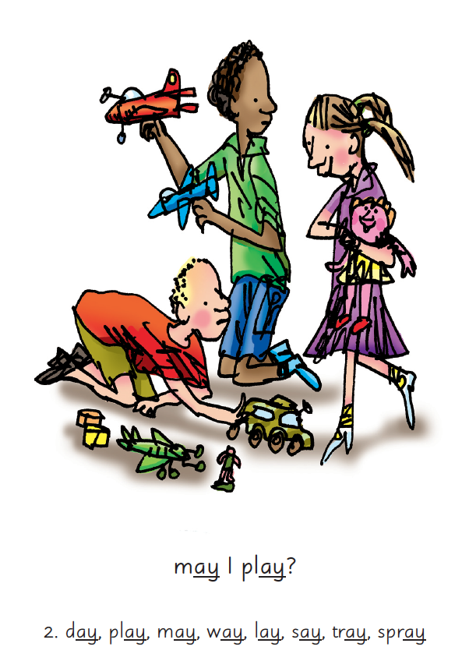

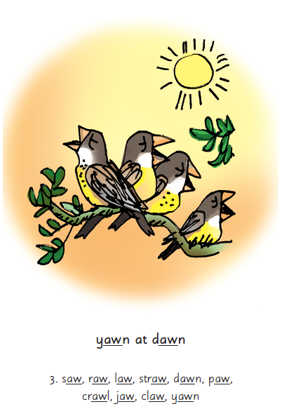
Picture Phrases
Notes:
We use picture phrases to help children remember the Set 2 and Set 3 sounds.
For example, ay, may I play? aw, yawn at dawn

Slide 6


‘Special Friends’, ‘Fred Talk’, read the word
Notes:
Then children practise reading these sounds in words using the routine ‘Special Friends’, ‘Fred Talk’, read the word’.
They spot the ‘Special Friends’ first, then Fred Talk to read the word.
For example, ‘ay’, s-p-r-ay, spray.

Slide 7
What can you do?
Practise the sounds and phrases
Practise reading sounds speedily -
‘review, review, review’
Use ‘Special Friends’, ‘Fred Talk’,
read the word’ to read words
Notes:
You can purchase Set 2/3 flashcards or My Reading and Writing Kit ages 5-7 becoming a reader to support your child with Set 2 sounds at home.

Slide 8
Online resources available
Ruth Miskin Parents’ Page:
http://www.ruthmiskin.com/en/parents/
Ruth Miskin Facebook:
https://www.facebook.com/miskin.education
Free e-books for home reading:
http://www.oxfordowl.co.uk/Reading/

Slide 9
Reading changes everything
Teach a child to read and keep that child reading and we will change everything.
And I mean everything.
Jeanette Winterson
Notes:
Remember that all parents have the power to change outcomes for their children.

