Slide 1
Read Write Inc. Phonics
Parents’ Meeting
Set 1 Sounds

Slide 2
Reading changes everything
Teach a child to read and keep that child reading and we will change everything.
And I mean everything.
Jeanette Winterson
Notes:
Read quote.
Today I want to help you understand how your child is learning to read with phonics – specifically ‘Read Write Inc.’ Phonics.

Slide 3
What is phonics?
Sounds
Graphemes
Notes:
All words are made up of individual sounds. These sounds are merged together to form words.
e.g. in ‘mat’ we have the sounds ‘m’, ‘a’, ‘t’, ship – ‘sh’, ‘i’, ‘p’.
A grapheme is another name for the letters we use to write the sound. The spelling of that sound on the page.
Phonics is the method of teaching reading through the identification of sounds and graphemes.
The new National Curriculum ensures that all children are taught Phonics systematically.
This gives your children the tools to read any word.

Slide 4
English alphabetic code
44 sounds
26 letters
Over 150+ graphemes (letter combinations)
One of the most complex alphabetic codes in the world.
Notes:
We use 44 sounds to make all the words in the English language.
This means we’ve got a problem.
We’ve got 44 sounds and only 26 letters.
The 26 letters work singly, in pairs and sometimes in threes to represent one sound.
We have to group letters together to write some sounds e.g. ‘igh’, ‘air’.
In English we have more than 150 ways to represent 44 sounds, using the 26 letters in the alphabet.
This makes our language one of the most complex in the world!

Slide 5
Speed Sounds Set 1
Notes:
Using RWI, we make learning to read easy for children because we start by teaching them just one way of reading and writing every sound. Here they are on the Simple Speed Sounds chart.
We teach Set 1 sounds first - (sounds as far as a e i o u).
Children need to know sounds – not letter names – to read words.

Slide 6
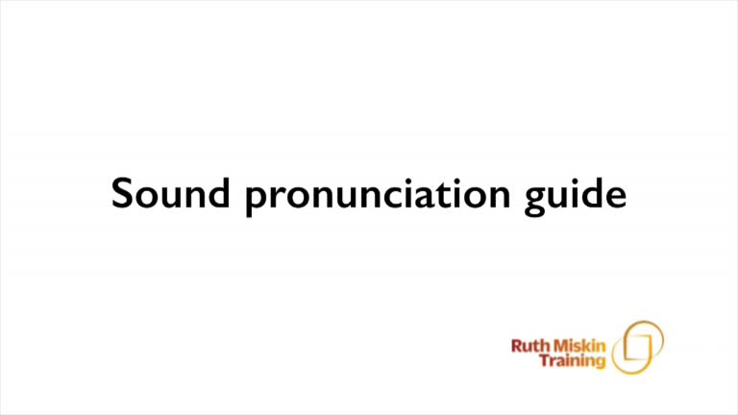
Pure Sounds (ruthmiskin.com)
Notes:
We teach using pure sounds.
We pronounce the sounds clearly, using pure sounds (‘m’ not’ muh’, ’s’ not ‘suh’, etc.) so that your child will be able to blend the sounds together to make words more easily.
You can watch this film of little Sylvie on the Ruth Miskin website to practise using pure sounds. Play a little bit of the video.

Slide 7
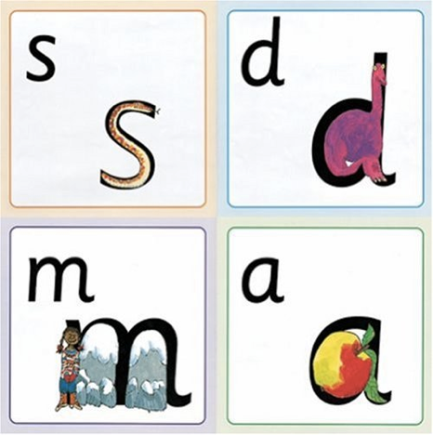
Name the pictures
Notes:
We give children a hook to learn the sounds by using pictures in the same shape as the letter.
‘s’ looks like a snake.
‘d’ looks like a dinosaur.
‘m’ looks like a mountain.
‘a’ looks like an apple.
We teach the children to name the mnemonic pictures before they learn the sound.
This means that children learn to read and write the sounds really easily.

Slide 8
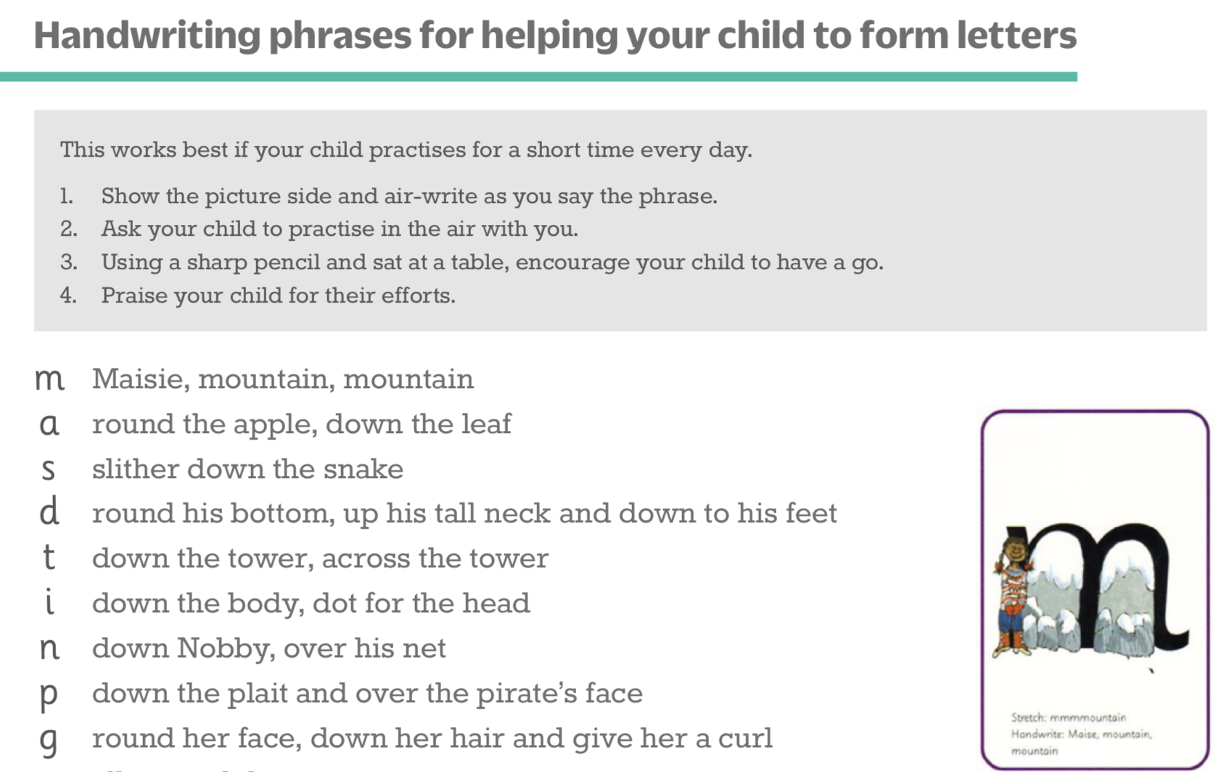
Teaching letter formation
Notes:
Children use the picture mnemonic to learn to form letters correctly at the same time they learn to read each sound.
Each sound has a handwriting phrase e.g. down Maisie, and over the mountains.
Use these handwriting phrases when practising writing at home with your child.
Avoid using these to read the sound.

Slide 9
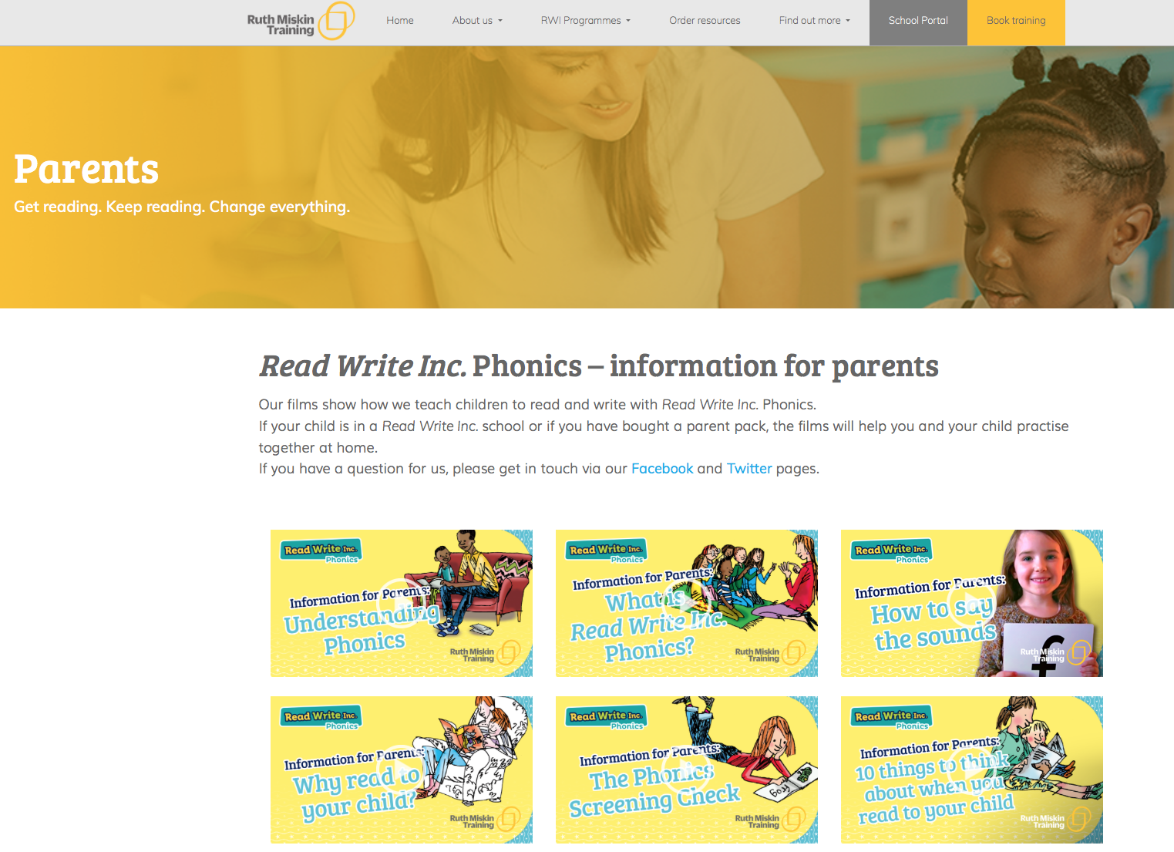
Free Video Tutorials (ruthmiskin.com)
Notes:
Watch these video tutorials on the Ruth Miskin website to help you to practise reading and writing with your child at home:
The frieze
reading the stretchy sounds with your child
reading the bouncy sounds with your child
Handwriting

Slide 10
What can I do?
1. Use pure sounds, not letter names
2. Teach the picture names
3. Practise reading sounds speedily -
‘review, review, review’
4. Use the handwriting phrases for writing only

Slide 11
Online resources available
Ruth Miskin Parents’ Page:
http://www.ruthmiskin.com/en/parents/
Ruth Miskin Facebook:
https://www.facebook.com/miskin.education
Free e-books for home reading:
http://www.oxfordowl.co.uk/Reading/

Slide 12
Reading changes everything
Teach a child to read and keep that child reading and we will change everything.
And I mean everything.
Jeanette Winterson
Notes:
Remember that all parents have the power to change outcomes for their children.

